Slide 1
Data Science Rookies Group Project 1
Sunroof Project Analysis
Team #4
Bradley Reardon, Pranay Bhakthula, Baldur Hua, Jichong Wu, Qinyuan Xing

Slide 2
Jichong Notes to all [delete this page after clean up]
At this point and for my work to be helpful to the team, I thought more is better. So I added slides/sections as many as I can, for you guys to do minus work =)
Pls feel free to drop/change anything
Chart numbering in yellow highlight, can be removed later, including for now so it’s clear for you to track my thoughts
Brad: my edits are in red where I changed your line – feel free to edit again

Slide 3
Delete this(Baldur)
I added few things based on the latest ‘patch’ by Jichong.
Make sure we review the whole thing before submitting.
There may be some inconsistence.

Slide 4
Outline
Data Set Overview
Exploratory Data Analysis
Model Building
Conclusions
Prediction (If time allows)

Slide 5
Data Set Overview

Slide 6
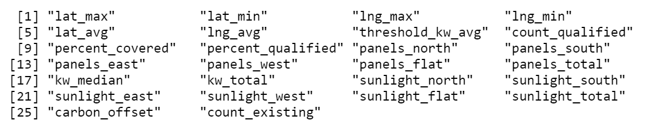
Data Set Overview
The dataset, compiled by the Google Sunroof Project, contains the estimated number of solar panels, amount of solar energy generated, and carbon dioxide abatement in cities throughout the United States.
Dataset Source: Kaggle
7,899 observations and 26 variables (After rearrangement)

Slide 7
S.M.A.R.T Questions
Analyze the effects of estimated annual sunlight and number of potential panel types on the total solar energy generation potential per US city and region.
Determine which variables significantly effect the estimated carbon dioxide abatement.
Compare mean potential solar energy generation per panel type by region.

Slide 8

Exploratory Data Analysis

Slide 9
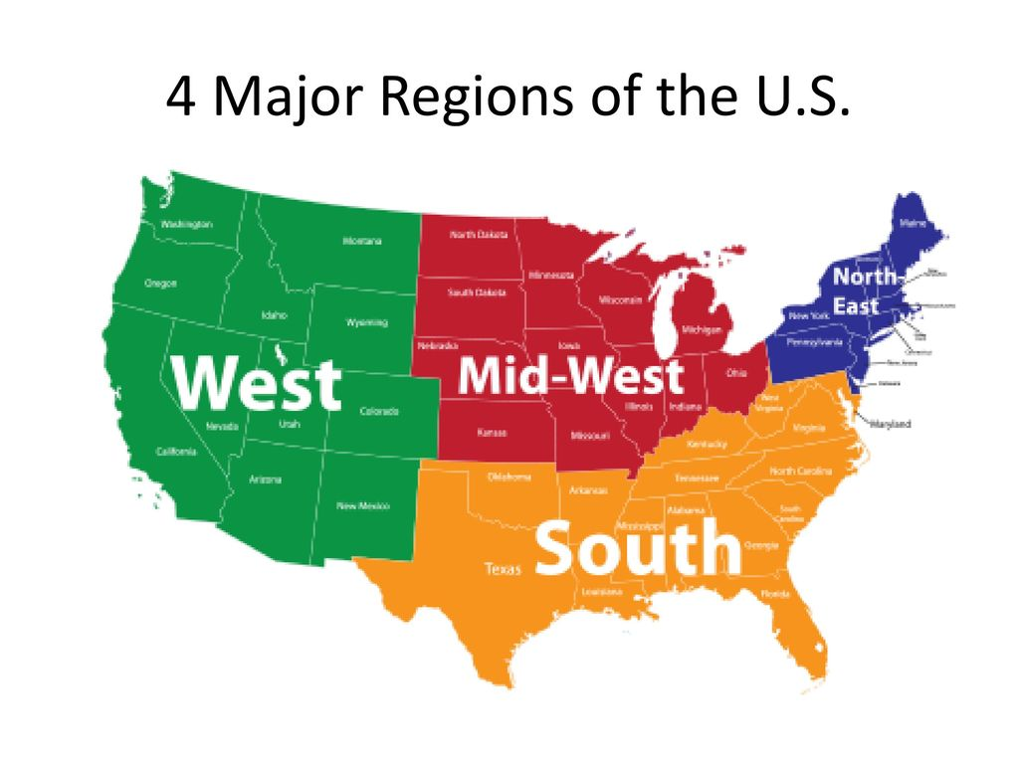
To Prepare for EDA:
Dropped 3 variables: median number of panels, median yearly sunlight (used mean values instead), install size (irrelevant to our analysis)
Shortened/renamed column titles for readability
Changed data types for numerical columns from string to numeric.
Excluded the NA values.
Created the region column as factor data for comparison analysis
Four levels: Northeast, South, Midwest, West

Slide 10
Exploratory Data Analysis
Data aggregates overview
Count total # of cities by region (chart1)
Count total # of solar panels with direction breakdowns by region (chart2)
Count total solar energy production potential by region (chart3)
Get additional independent variables
Calculate the average solar energy potential generated by each panel by region (charts 4-8, table1)
Find sunlight energy potential per panel per direction for each city
i.e. sunlight_north / panels_north = estimated total solar energy generation potential per panel in city x
Relationship check for model building (below 4 + above 2)
Any relationship between carbon offset and solar panels? (linear-plot + cor test)
Any relationship between carbon offset and solar potential? (linear-plot + cor test)
Any relationship between carbon offset and solar panel direction? (linear-plot + cor test)
Any relationship between carbon offset and solar location (use lat, long data)? (linear-plot)

Slide 11
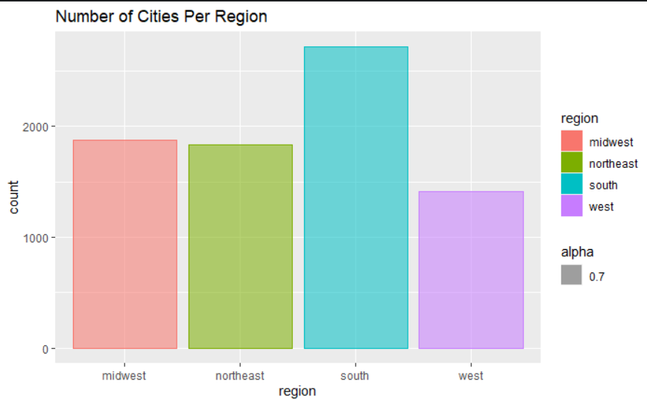
Total # of Cities by Region – Chart1

Slide 12
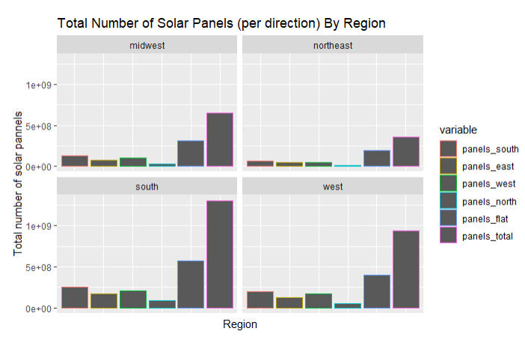
Chart 2 Total number of solar panels with direction breakdowns by region

Slide 13
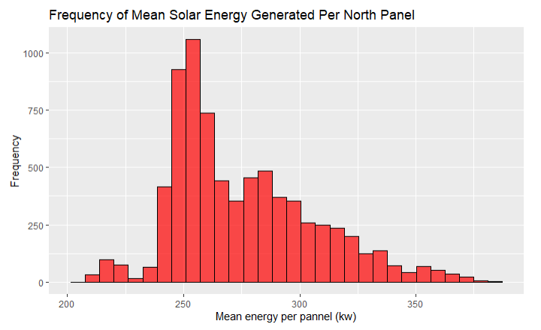
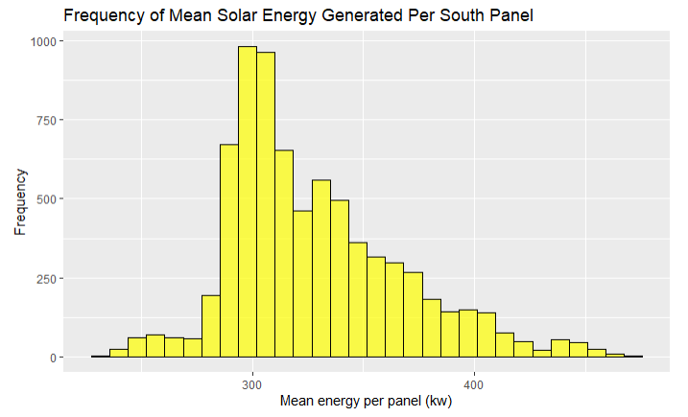
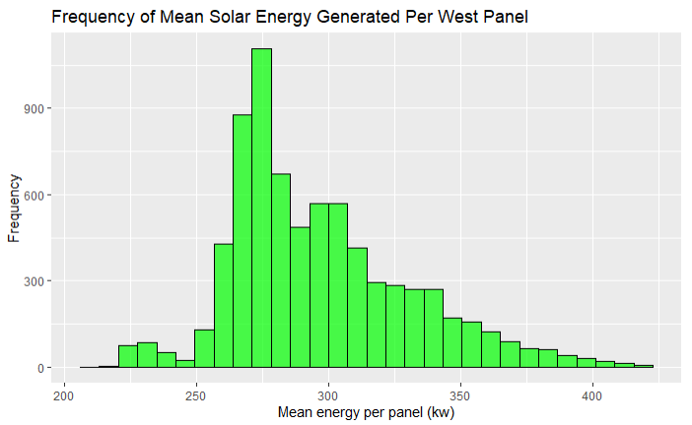
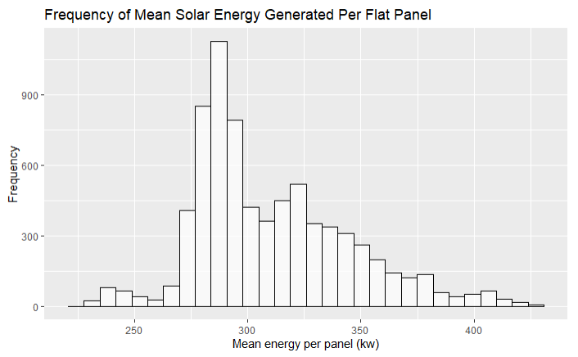
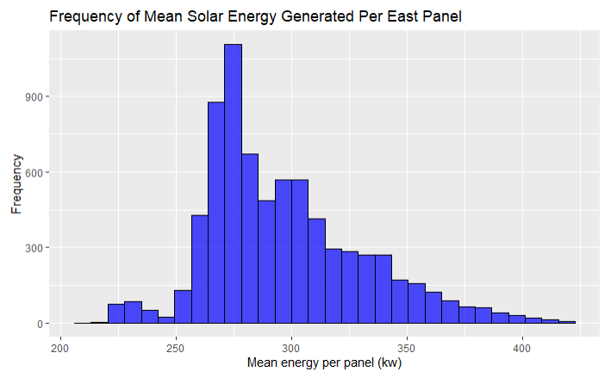
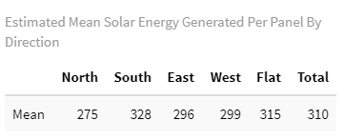
Mean Solar Energy Potential Generated Per Panel By Direction – Charts 4-8

Slide 14
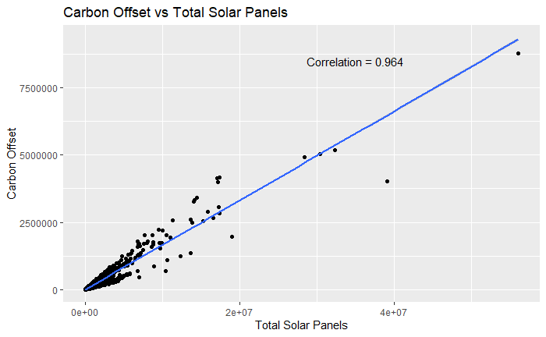
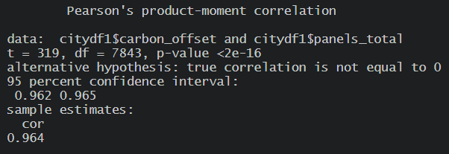
Does Total # of Solar Panel Have a Relationship with Carbon Offset Potential?

Slide 15
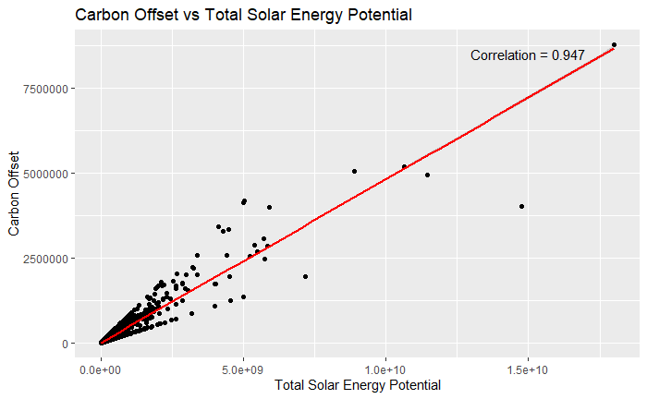
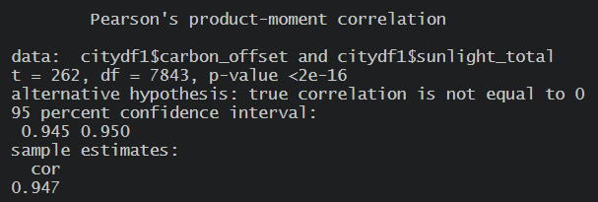
Does Total Solar Energy Potential have a relationship with Carbon Offset Potential?

Slide 16
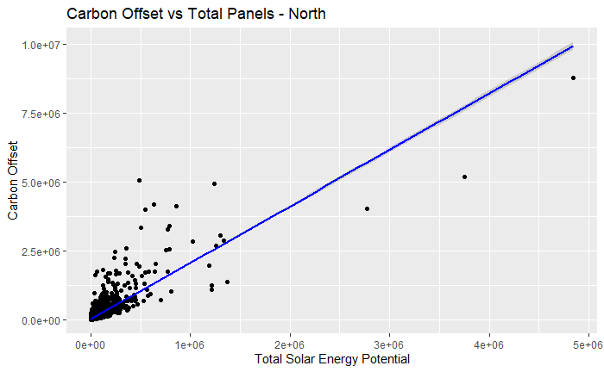
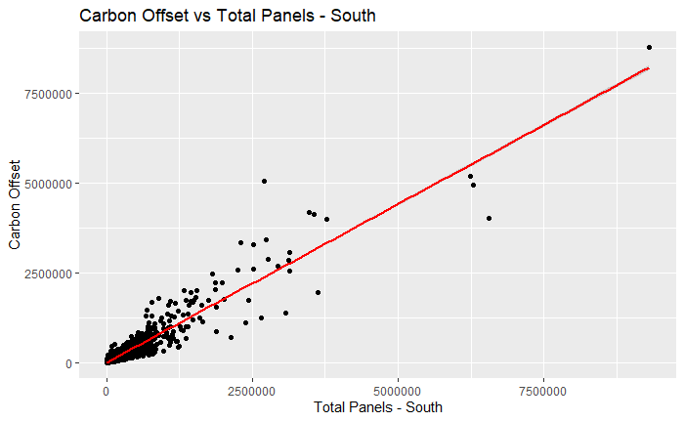
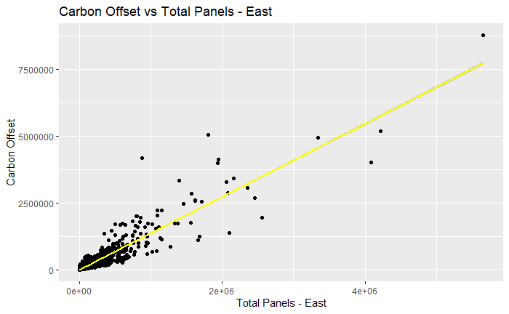
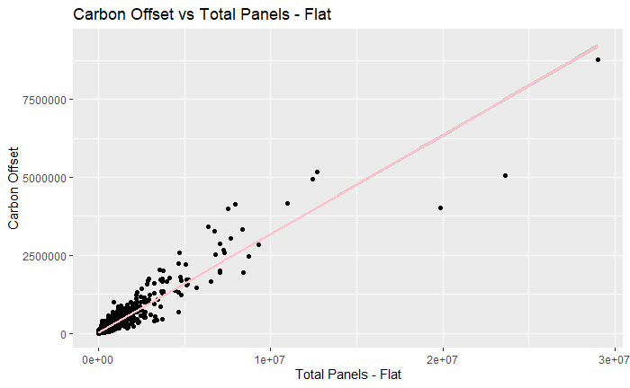
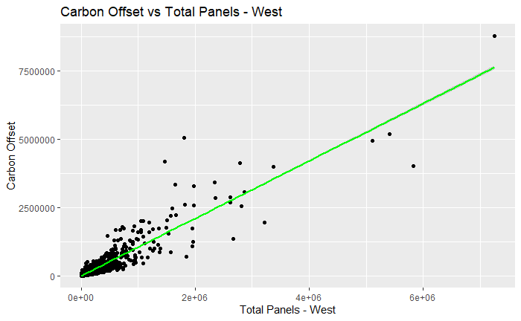
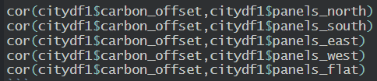
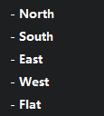
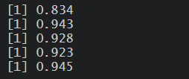
Does Solar Panel Direction Has a Relationship with Carbon Offset?

Slide 17
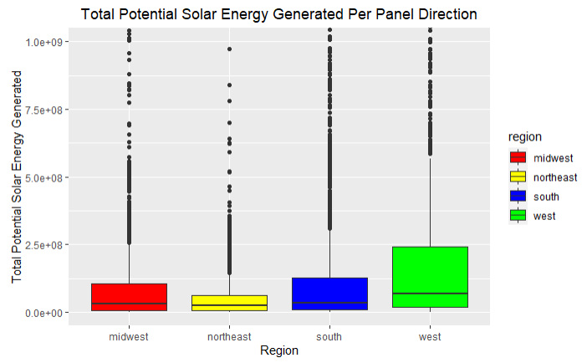
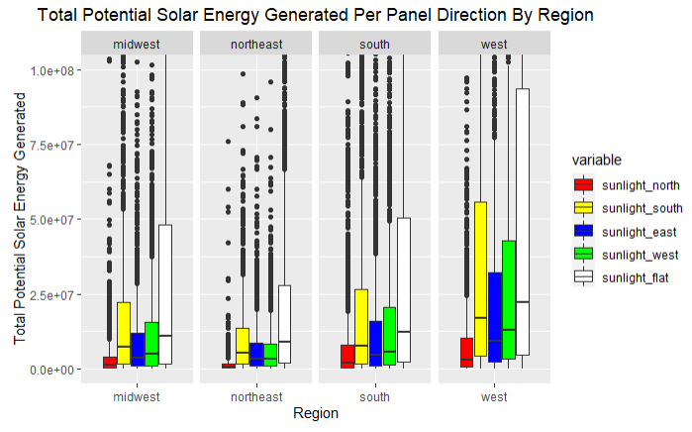
Does Location Have a Relationship with Carbon Offset?
Total solar energy production potential by region

Slide 18
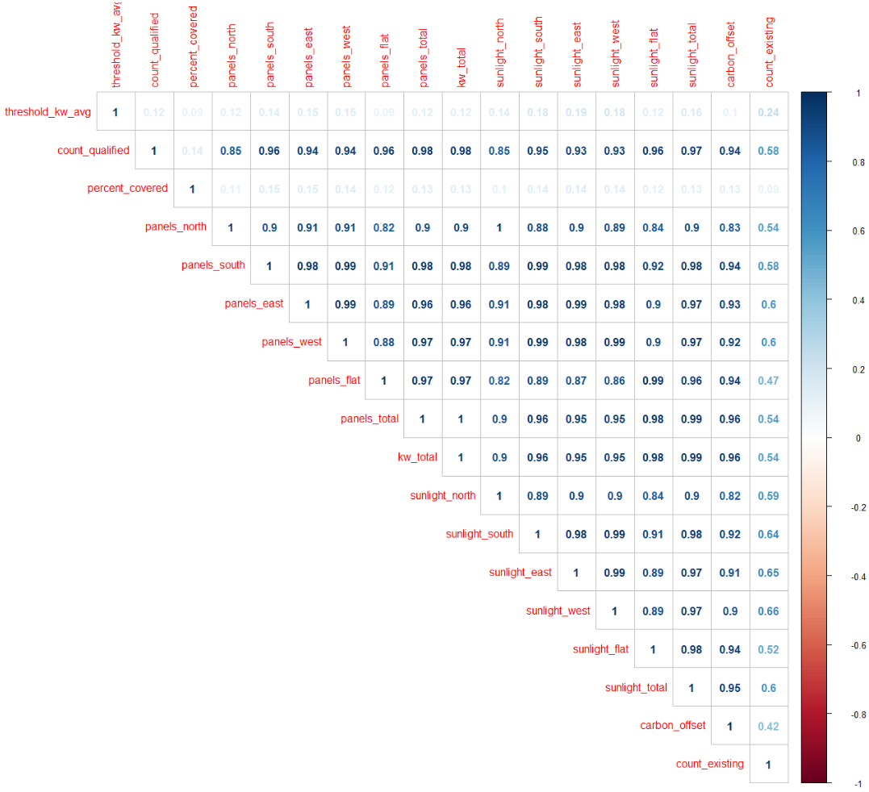
Heatmap For Correlation Checking

Slide 19
Model Building

Slide 20
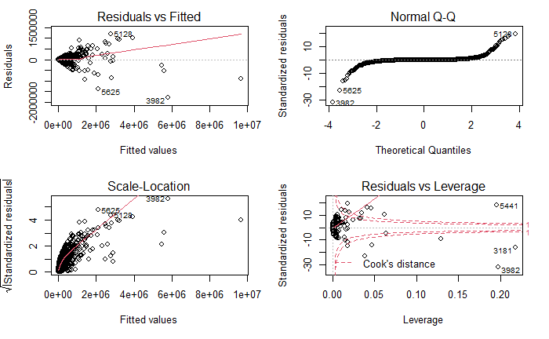
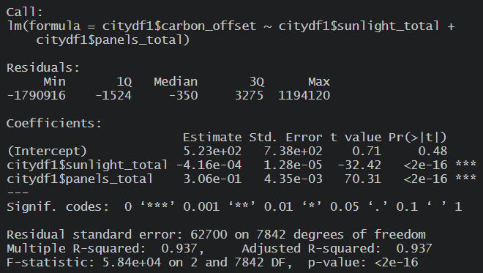
Model 1 (carbon offset ~ total solar energy potential + total # of solar panel)

Slide 21
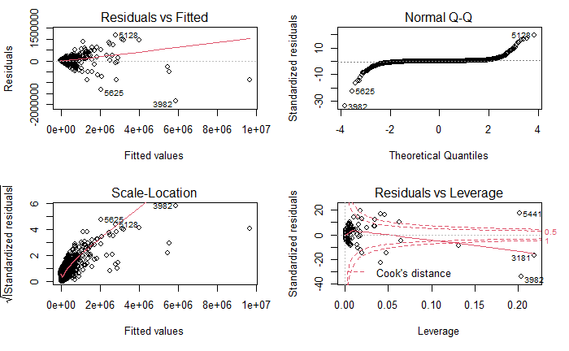
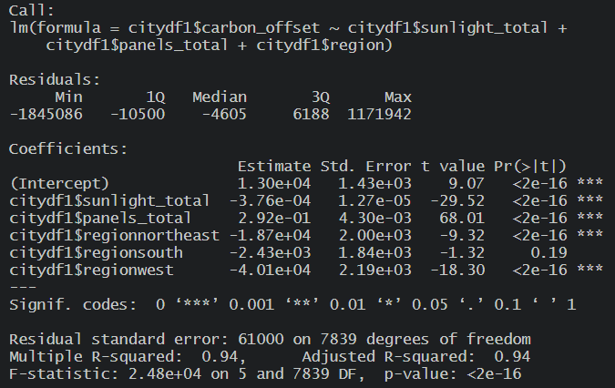
Model2 (carbon offset ~ total solar energy potential + total # of solar panels + regions)

Slide 22
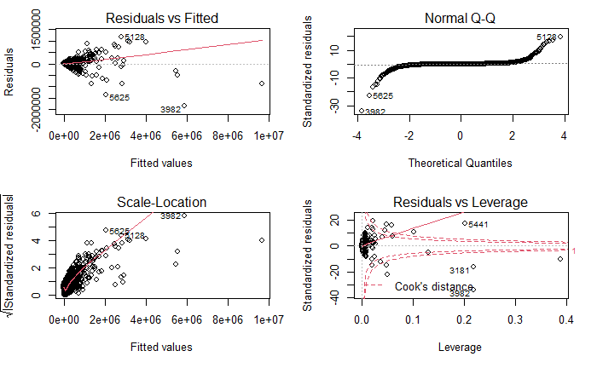
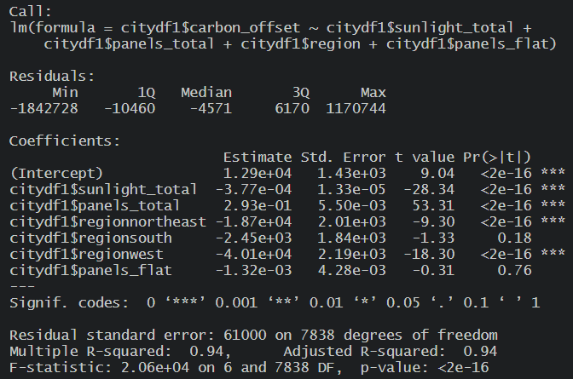
Model3 (carbon offset ~ total solar energy potential + total # of solar panels + regions + all flat panels – delete this notes – flat panels have the highest correlation with y, that’s why include here first)

Slide 23
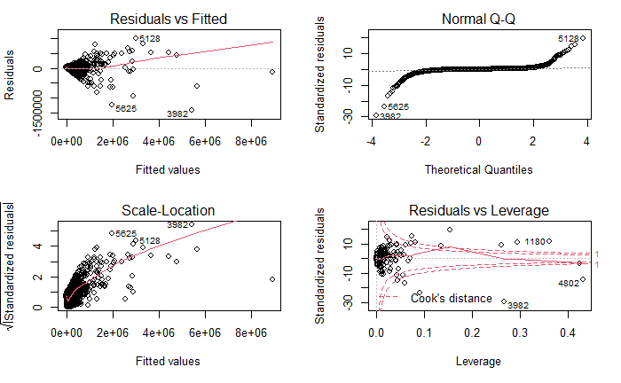
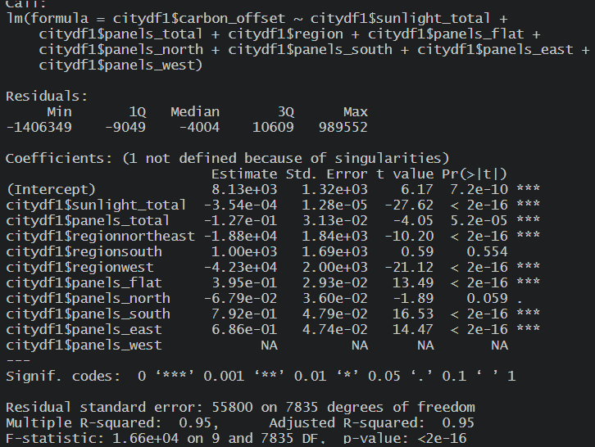
Model4 (carbon offset ~ total solar energy potential + total # of solar panels + regions + all flat panels – delete this notes – cook doesn’t look good, so we add all panel directions this time)

Slide 24
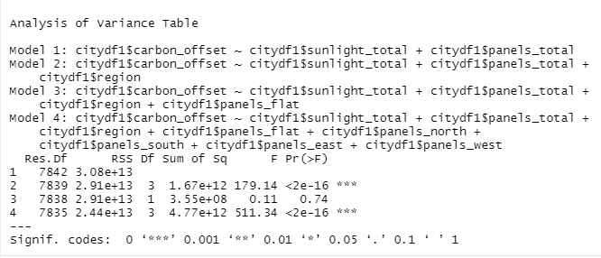
ANOVA Test On Our Four Models
Adding only the flat_panels variable in model 3 proves to be insignificant.
Model 4 shows an overall model significance after adding all panel type variables.

Slide 25
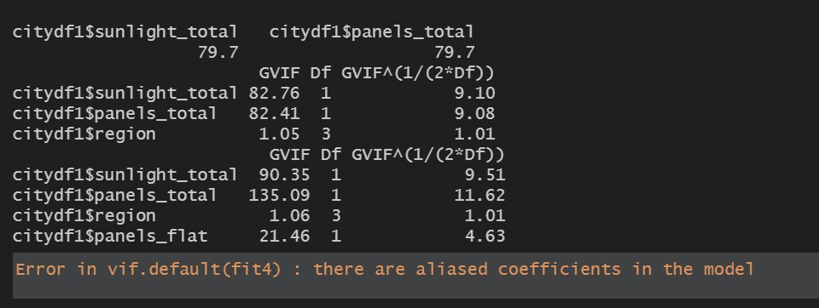
VIF test on all the variables
From the vif tests on the models we can observe that only region variable has acceptable vif values, rest all the variables have high multicollinearity.
The vif test for model4 indicates presence of aliased coefficients in the model which means that the addition of remaining 4 directional panels to the model is resulting in perfect multicollinearity, which is not acceptable at all.

Slide 26
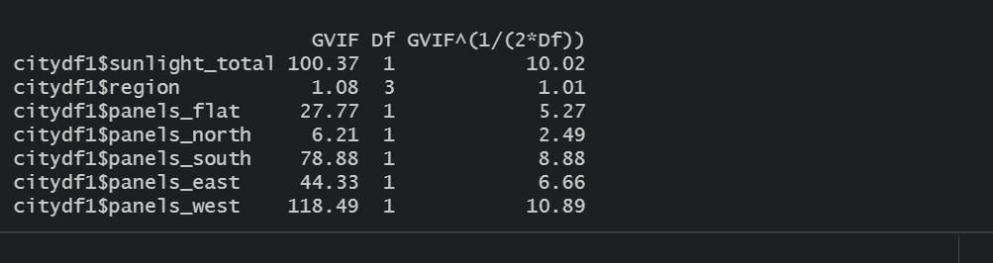
VIF test on all the variables
Since model 4 had linearly dependent variables we remove `panels_total` from the model and we do vif test again.
From the vif test we can observe that only ‘panels_north’ has acceptable vif values, rest of the directional panels have high multicollinearity.

Slide 27
Conclusion

Slide 28
Needs to be better worded or explained
Model 4 is the best:
P-value < 0.05
Multiple R-squared is 95%
Cook’s < 1
The model indicates that:
The more flat, more carbon offset
Adding more solar panels in the South region, help reduce carbon emissions the most
Adding more solar panels in Northeast and West, will actually increase carbon emissions
Installing solar panel facing South and East will help reduce carbon emissions the most
Installing solar panel facing North will actually increase carbon emissions

